Slide 1
Plane Detection from Monocular Images
-Srinath.V.S

Slide 2
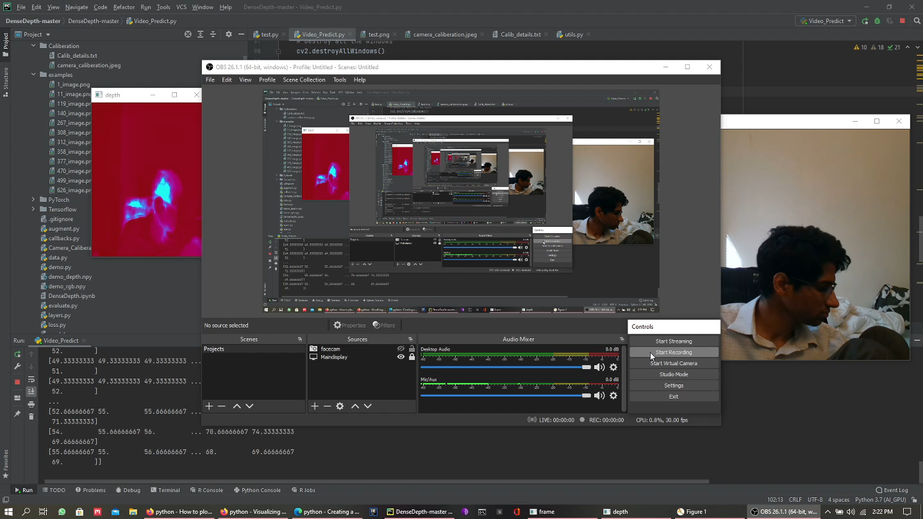
Sample Output

Slide 3
The Pipeline
Input
Depth_Estimation Model
Point cloud Estimation
Visualization
Plane Estimation

Slide 4
Depth Estimation Model
This is the ML model based on a Style transfer GAN used to find the depth images from the NYU-V2 dataset.
The encoder is based on Densenet-169, with weights loaded from Imagenet. This cut down my training process, and I practically only had to train my decoder.
The decoder had to be upscaled to get back the original resolution, I missed one layer in my calculations and ended up with half the resolution of the encoded image as my depth image prediction. This does not affect the actual predictions in any way, as it was trained this way.

Slide 5
Point cloud Estimation
Initially, I was keen on using a package called Open3D to render my point clouds from the depth image, but then I decided to write my own, due to undebuggable errors.
The camera is calibrated using Camera Caliberation, one of the caliberation values is chosen to evaluate focal length and camera centre parameters.
The depth image is then used to estimate x,y and z values based on camera caliberation parameters.

Slide 6
Visualization
This involves rearranging the scales of the numpy arrays and then plotting the point cloud obtained.
This proved to be rather inaccurate due to camera caliberation difficulties and general issues with my implementation, ranging from lighting to the way the dataset was structured. The dataset was primarily meant for segmentation of objects, hence, considered a homogeneous object to be of the same depth, which can be seen in the depth images.

Slide 7
Plane estimation
Find edges, find if edges are parallel by undistotring the edges based on camera calibration parameters, use the point cloud to see what edge lie in the cloud. Or make the cloud as a set intersection of points on the edges and the points in the depth image.
Then using the parallel edges, fit a plane. If some other edge is also found that can be parallel to these two edges, extend the plane.
Once a plane of maximal size has been found, check of normal to any of the edges to detect vertical planes.

Slide 8
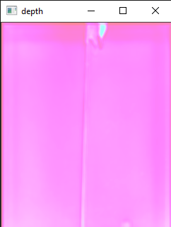
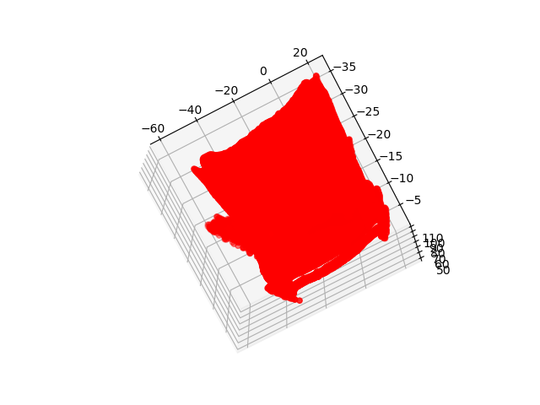
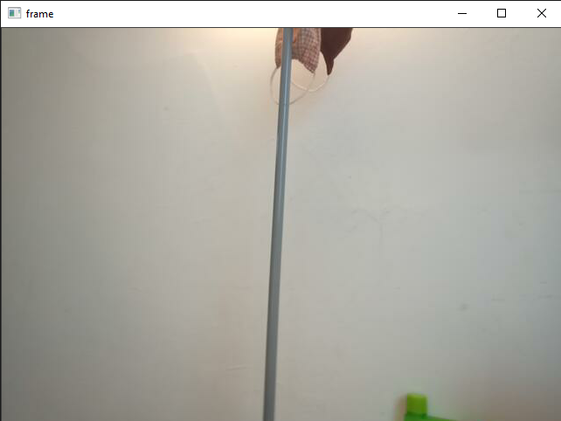
Sample Outputs :

Slide 9
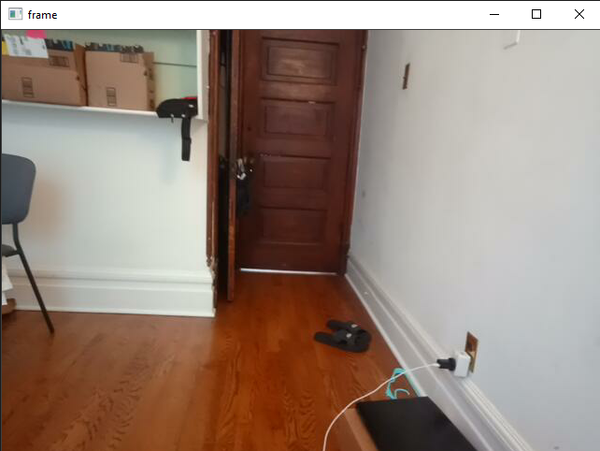
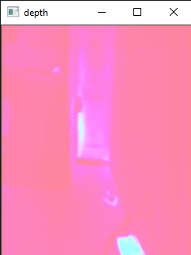
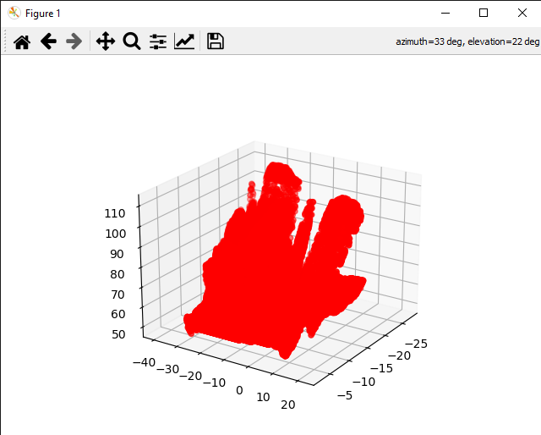

Slide 10
Background Work :
This system has been previously used for Segmentation and for estimation of contours.
This has also allegedly been used for plane estimation using inverted depth images.
Style Transfer networks have been used predominantly as image filters, so, this can be considered to be a depth evaluation filter.

Slide 11
Inference :
While it is possible to get depth maps from RGB monocular images, the conversion of the depth images to point clouds seems a lot harder and a lot less accurate as it is severely impeded by camera caliberation parameters.
The plane estimation is even more harder in a XYZ system, as planes need to be fit based on some base criterion which may mean multiple traversals in all three x, y and z arrays.
It might be possible to combine edge detection with point clouds to make the plane estimation easier.
The system struggles with shadows, and black surfaces, it simultaneously assumes the surface to be at both max distance and very close to the surface at the same time.

Slide 12
Depth Normalization Removal
This allowed for more distinct point clouds. The depth normalization was setting depth values between a range of 0 to 1, this was reducing the amount of difference in depth that could be visualized.
This came with its own issues with regards to depth estimation however, the depth ranges increased significantly, preventing any sharp feature estimation.

Slide 13
References
Citations :
Xiao, Junhao, Jianhua Zhang, Jianwei Zhang, Houxiang Zhang, and Hans Petter Hildre. "Fast plane detection for SLAM from noisy range images in both structured and unstructured environments." In 2011 IEEE international conference on mechatronics and automation, pp. 1768-1773. IEEE, 2011.
Han, Xiaoning, Xiaohui Wang, Yuquan Leng, and Weijia Zhou. "A Plane Extraction Approach in Inverse Depth Images Based on Region-Growing." Sensors 21, no. 4 (2021): 1141.
Madhuanand, L., F. Nex, and M. Y. Yang. "Deep learning for monocular depth estimation from UAV images." ISPRS Annals of the Photogrammetry, Remote Sensing and Spatial Information Sciences 2 (2020): 451-458.
Khan, Faisal, Saqib Salahuddin, and Hossein Javidnia. "Deep learning-based monocular depth estimation methods—A state-of-the-art review." Sensors 20, no. 8 (2020): 2272.
Rodrigues, Rômulo T., Pedro Miraldo, Dimos V. Dimarogonas, and A. Pedro Aguiar. "Active Depth Estimation: Stability Analysis and its Applications." In 2020 IEEE International Conference on Robotics and Automation (ICRA), pp. 2002-2008. IEEE, 2020.

